Slide 1
Final Design Report
Roll Transfer Machine
Mechanical Design II: 2254 MEMS 1029 SEC 1040
- Prepared by -
Irving Zhang, Anna Liu, Zhemeng Chen

Slide 2
Introduction
Purpose:
Design a machine to transfer industrial paper rolls with a 90° rotation using gears, bearings, and a lead screw mechanism.
The cycle takes 90 seconds (45 seconds transfer, 45 seconds return) and the machine transfers 30 rolls per hour, works16 hours daily.
Minimize the cost and power consumption, while ensuring safety (factor of safety > 2.0) and durability (10+ year lifespan)

Slide 3
Problem Statement
Components:
Lead screw mechanism
Gear train (Gears 1 & 2)
Bearings
Cradle
Shaft
Motor

Slide 4
Assumptions
The entire machine:
The operating temperature and environment are moderate
Components are kept at a stable, efficient, and suitable operating temperature
The support force for returning is negligible
All components are rigid
Cradle & roll
The roll is always close to the arm of the cradle during rotation, so there will be no additional shock load. The density of the paper is 980 kg/m3
Both cradle and shaft are made of steel, whose density is 2520 kg/m3
Shaft is considered solid.
Power screw:
Acme thread—When the lead screw is taking axial force, the lead angle λ is small enough to be neglected, only the effect of thread angle α considered.
Trapezoidal thread shape with a thread angle α=14.5 deg
Gears
All gears are spur gears.
The pressure angle is 20 degrees.
Bearing:
The bearings remain smooth enough for the duration of the work.

Slide 5

Design Overview-how the machine operates

Slide 6
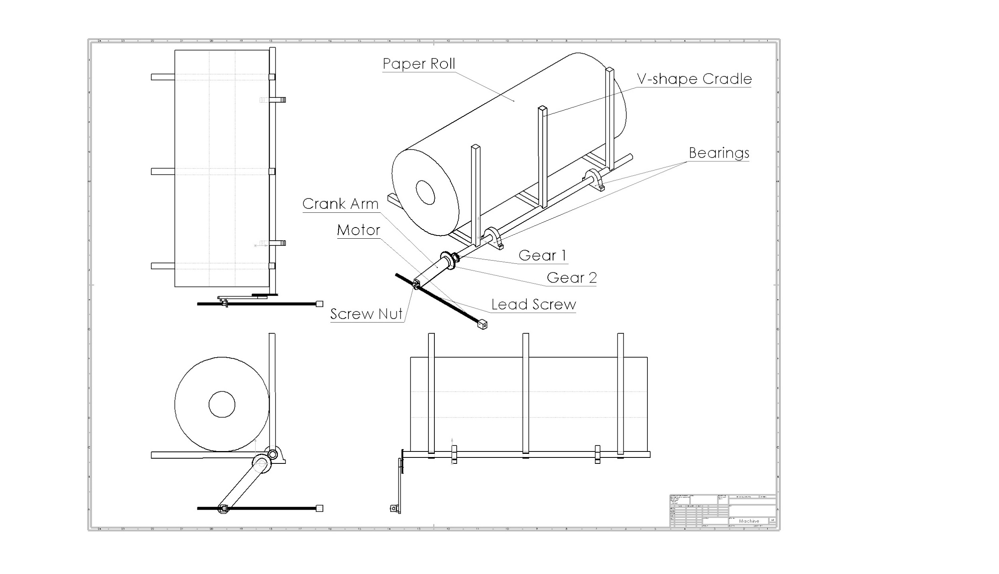
Design Overview-Key Component Locations

Slide 7
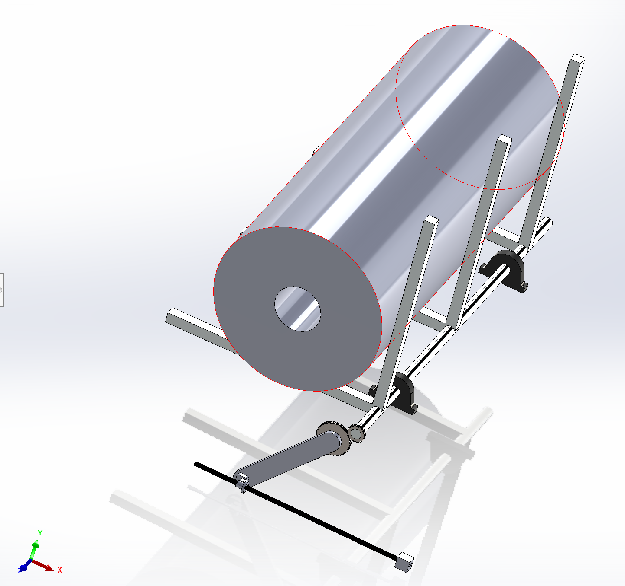
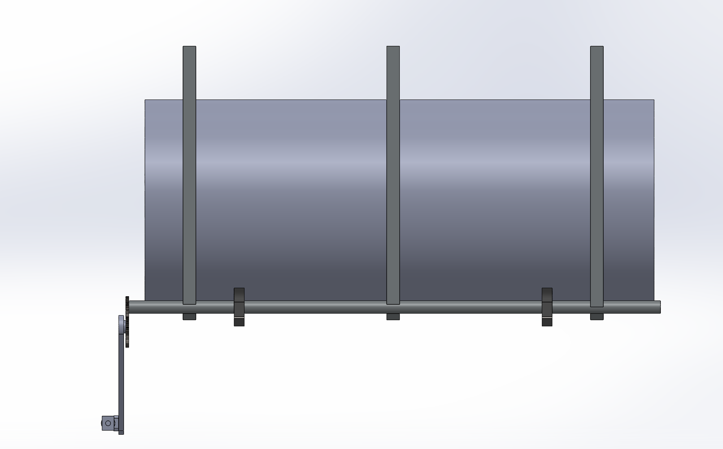
Design Overview-Key Component Locations

Slide 8
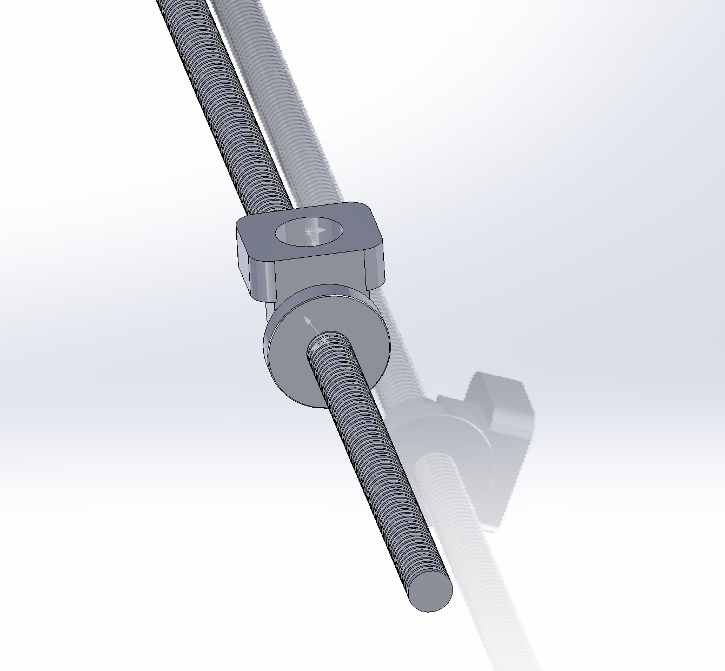
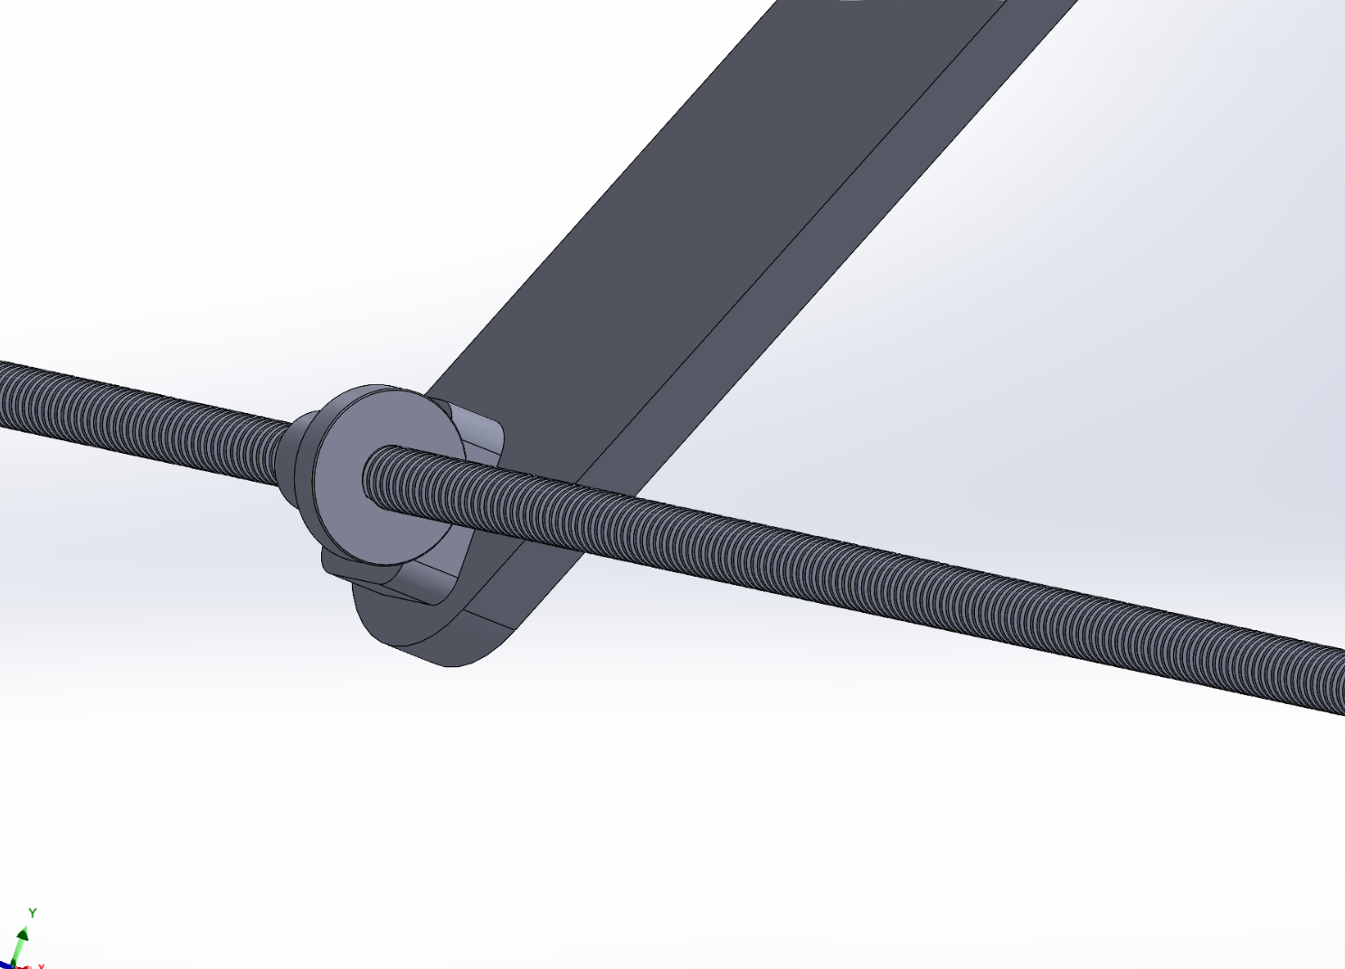
Design Overview-Lead Screw

Slide 9
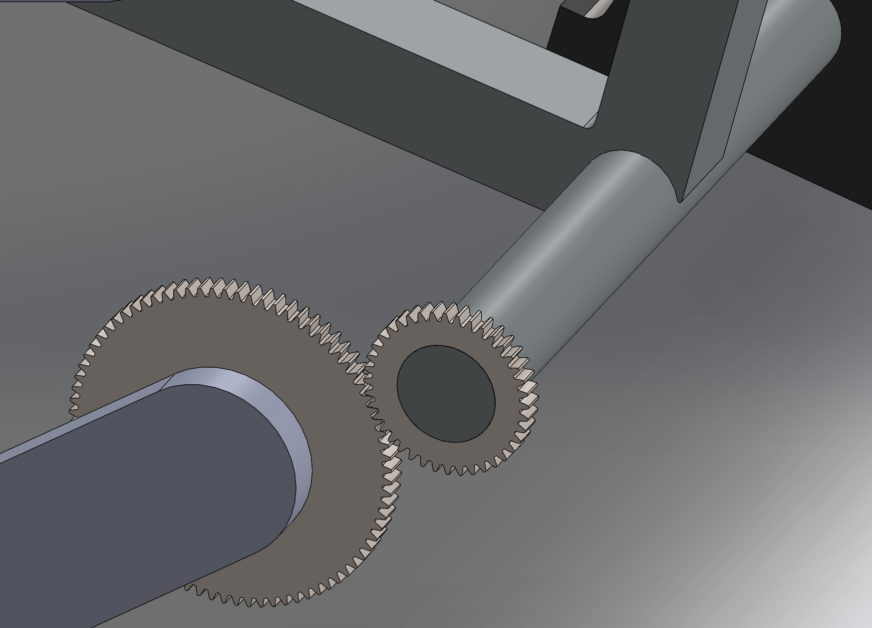
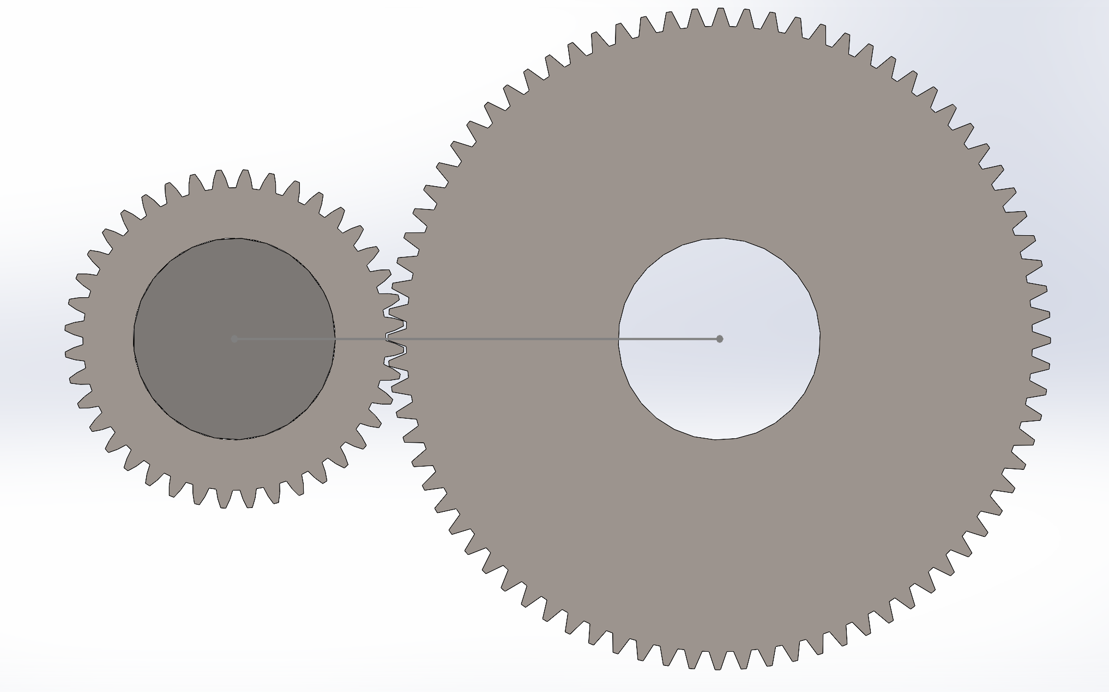
Design Overview-Gears

Slide 10
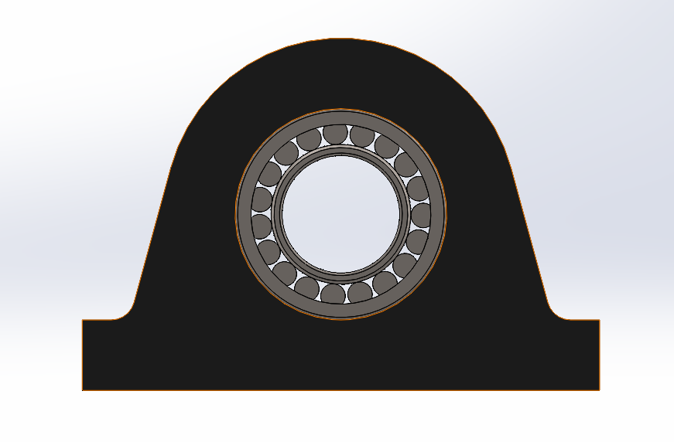
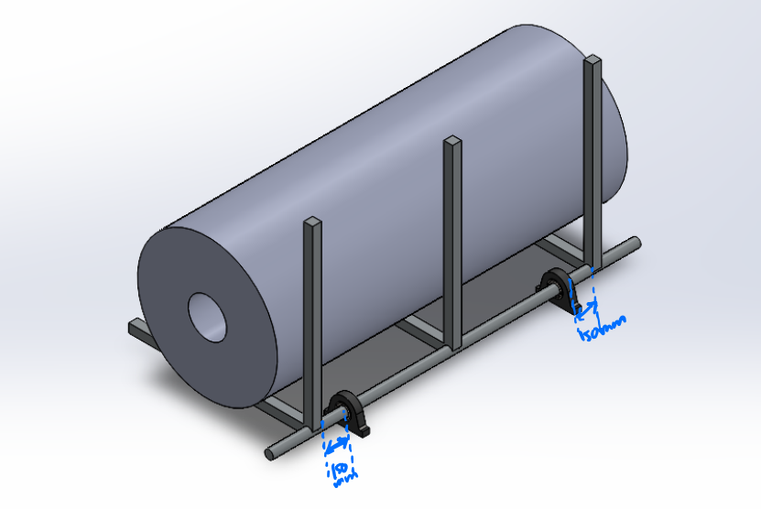
Design Overview-Bearings

Slide 11
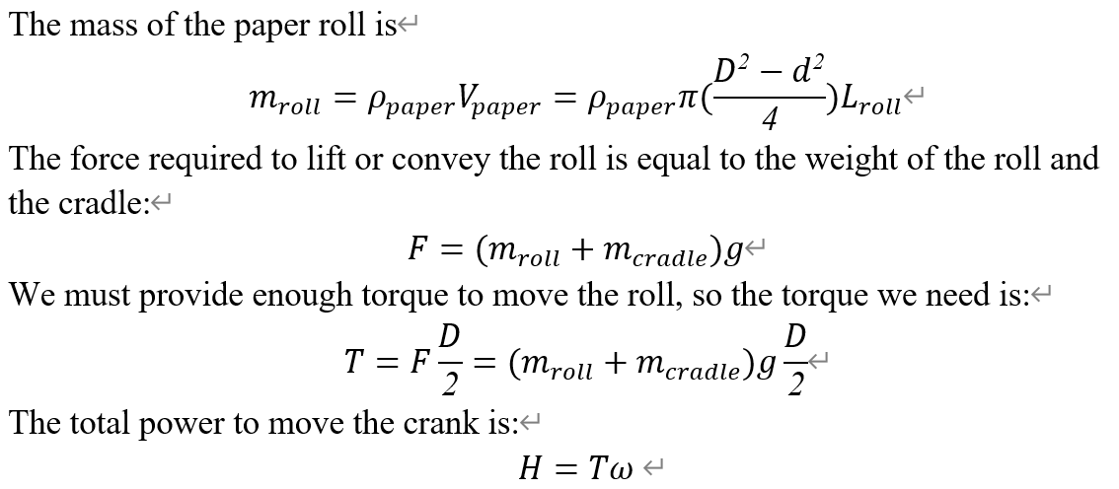
Design Overview-Mechanical power
The power we need to move the cradle and the paper roll
Notes:
density times volume, where the volume is calculated by known dimensions of the paper roll.
torque equals the gravitational force times the distance between the center of mass of paper roll to the shaft.
power=torque times angular velocity

Slide 12
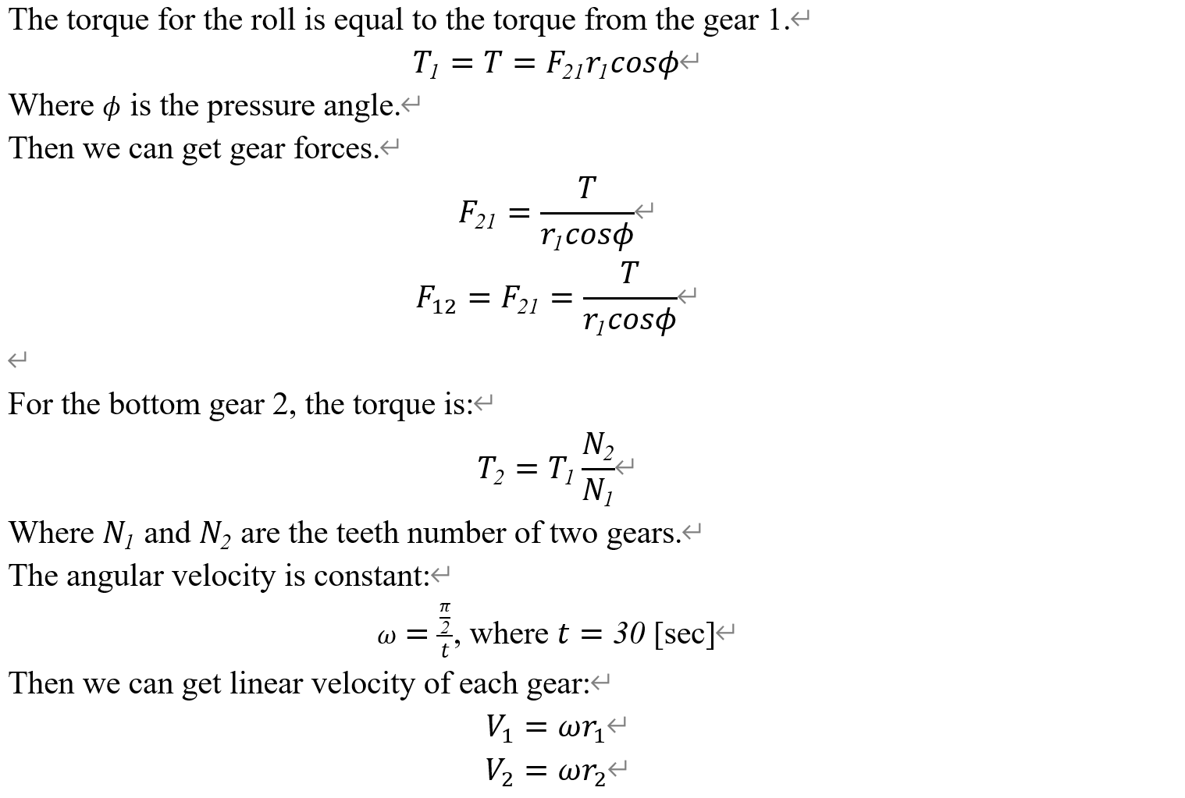
Design Overview-Mechanical power

Slide 13
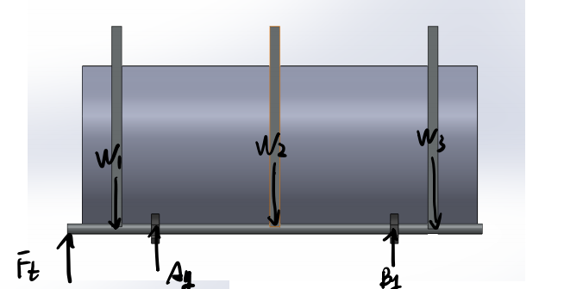
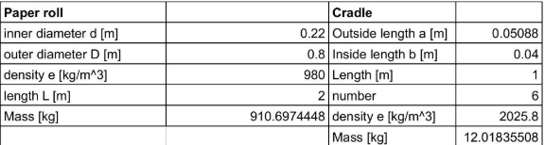
Technical Analysis-Bearings
During transferring the paper roller:
Weight of Load include shaft & cradle
W_{total} : 9051.83 N
Force provided by gears F_{t}: 48276.49 N
Notes:
To make sure the machine can operate for 10 years, We analysis the Free body diagram for the shaft as shown in the picture. Each of the six cradle arms shares a common support point on the shaft, so there are only three downward pressures on the shaft. Since the weight of the cradle and the paper roller is evenly distributed, each pressure w1, w2, w3 is 1/3 of the total weight. These three pressures are spaced 0.5 meters apart and the distance between w1 and w3 from the edge of the shaft is also 0.5 m. The total mass consists of the six cradle arms and the roller, the specific data are listed in the table below. During the first 45 seconds of the roller transfer, a geared force Ft is applied to the leftmost part of the shaft, which will be described later in the section on gears. Then the bearings provide a support force of 0.52544 meters on the each side closer to the shaft.

Slide 14
Technical Analysis-Bearings
During transferring the roller:
A_{y} = -70408.47 N
B_{y} = 31183.81 N
Lifetime: transfer 30 roller/hour, 16 hours/day, 5 days/week, 10 years
L₁₀ = 1248000 revolutions
Notes:
By using newton 2nd law, we got Ay equals to 70408.47 Netwtons in a downward direction while By as 31183.81 newtons in an upward direction
Then, analyze the lifetime. For the machine shoule be able to operate five days a week for 10 years, two eight-hour days, transfering 30 rollers per hour, and convert it into lifetime L10 is One million, two hundred and forty-eight thousand revolutions.

Slide 15
Technical Analysis-Bearings
During transferring the roller:
L₁₀ = (10⁶)(C₁₀/F)³
The minimum dynamic load ratings:
C_{10,A} = 75804.75 N
= 17041.59 lbs
C_{10,B} = 33573.82 N
= 7547.69 lbs
Notes:
According to the lifetime equation, the minimum dynamic load ratings are listed in units of both newton and pound-force. the subscript A represents the bearing A that close to the geartrain.

Slide 16
Technical Analysis-Bearings
Static Station:
F_{t} = 0 N
∵ Symmetric
∴ A_{y} = B_{y} = ½(W_{total}) = 4525.92 N
Static load rating:
4564.938 N = 1017.47 lbs
Notes:
We should also consider the static station that Ft equals to 0. Becasue it is symmetric, so we can easily get Ay and By is half of the total weight.

Slide 17
Technical Analysis-Bearings
Speed:
Rotate 180° in 90 seconds:
(180°/90s)(1rev/360°)(60s/min) = 0.333 rpm
Transfer 30 rollers per hour:
(30rollers/hour)(180°/rollers)(1rev/360°)(60s/min) = 0.25 rpm
Notes:
Before we select the atcual bearings, we should make sure that the maximum rotation speed is larger than the speed when the machine works. There are two requirements, first is The system budget allows 45 seconds to transfer a roll, and another 45 seconds to return (unloaded) to the home position for the next roll. In this case, the speed is 0.333 revolutions per minute. Another speed requirement is trasfering 30 rollers per hour, which is 0.25 revolutions per minute.

Slide 18
Technical Analysis-Bearings (Summary)
Requirement for Bearing 1 (The one close to gears):
Dynamic load rating:
C_{10,A} ≥ 75804.75 N
Static load ratings:
P_{static} ≥ 4525.92 N
Speed:
ω ≥ 0.34 rpm
Requirement for Bearing 2 (The one far to gears):
Dynamic load rating:
C_{10,A} ≥ 33573.82 N
Static load ratings:
P_{static} ≥ 4525.92 N
Speed:
ω ≥ 0.34 rpm
Notes:
The most of load on the bearings and shaft is the paper roller, the return motion is negligible, and I didn’t consider it when caculating the lifetime and dynamic load rating. The all requirements for selecting the bearings are here. For the two bearings have two different dynamic load capacities, we can try to use two different bearings to minimize the cost.

Slide 19
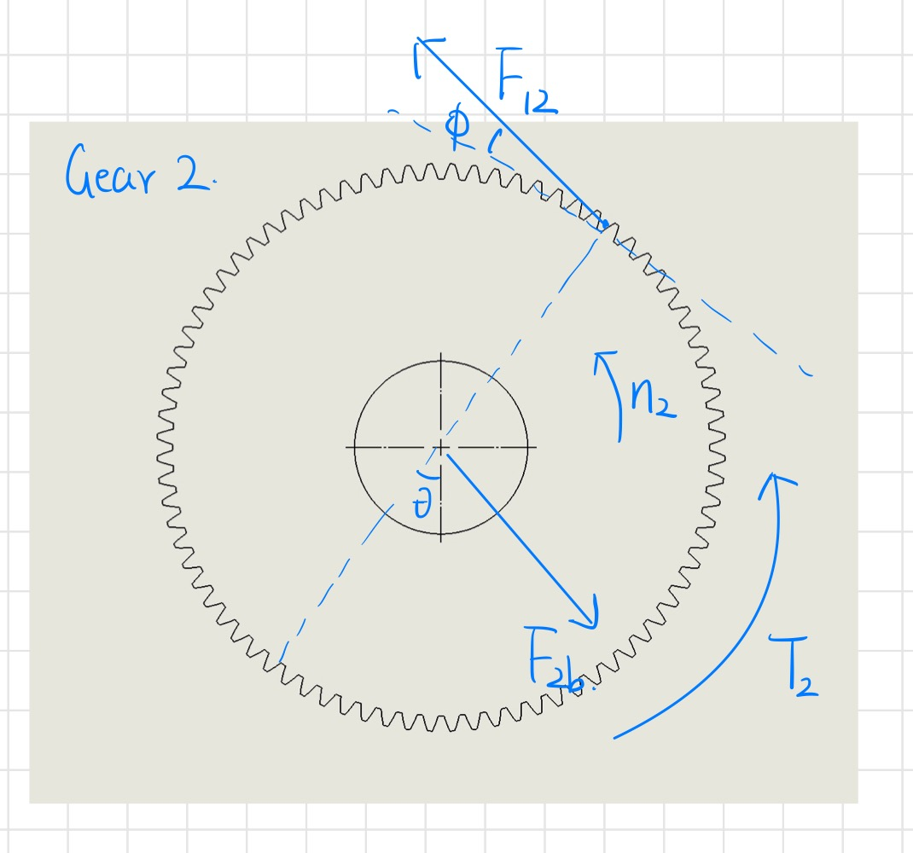
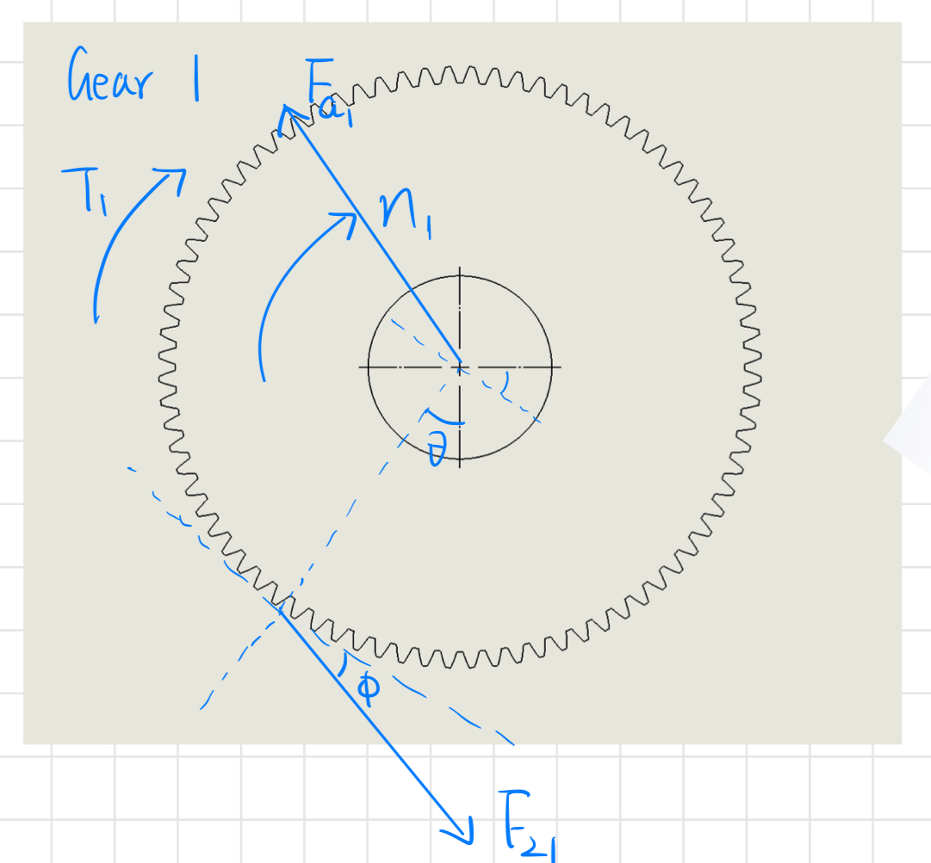
Technical Analysis-Gears

Slide 20
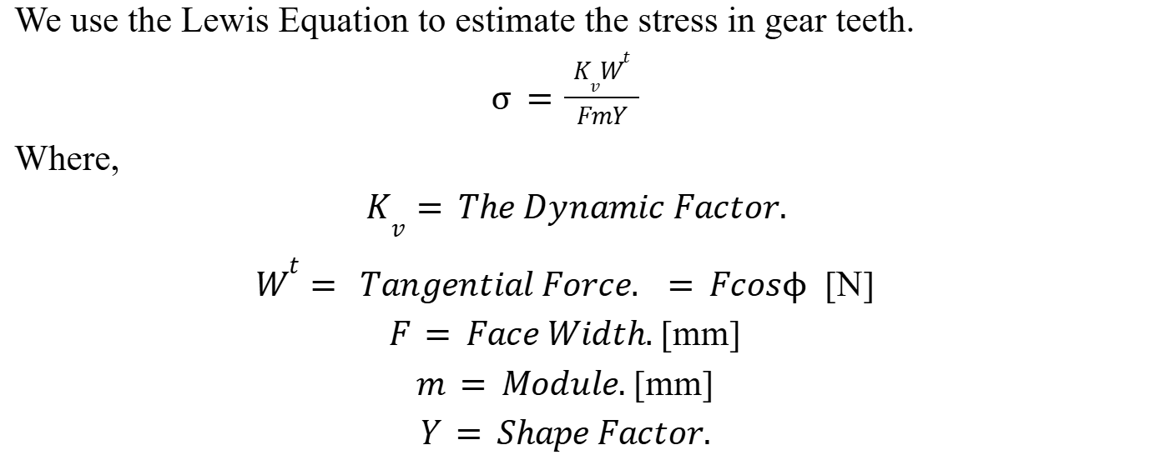
Technical Analysis-Gears

Slide 21
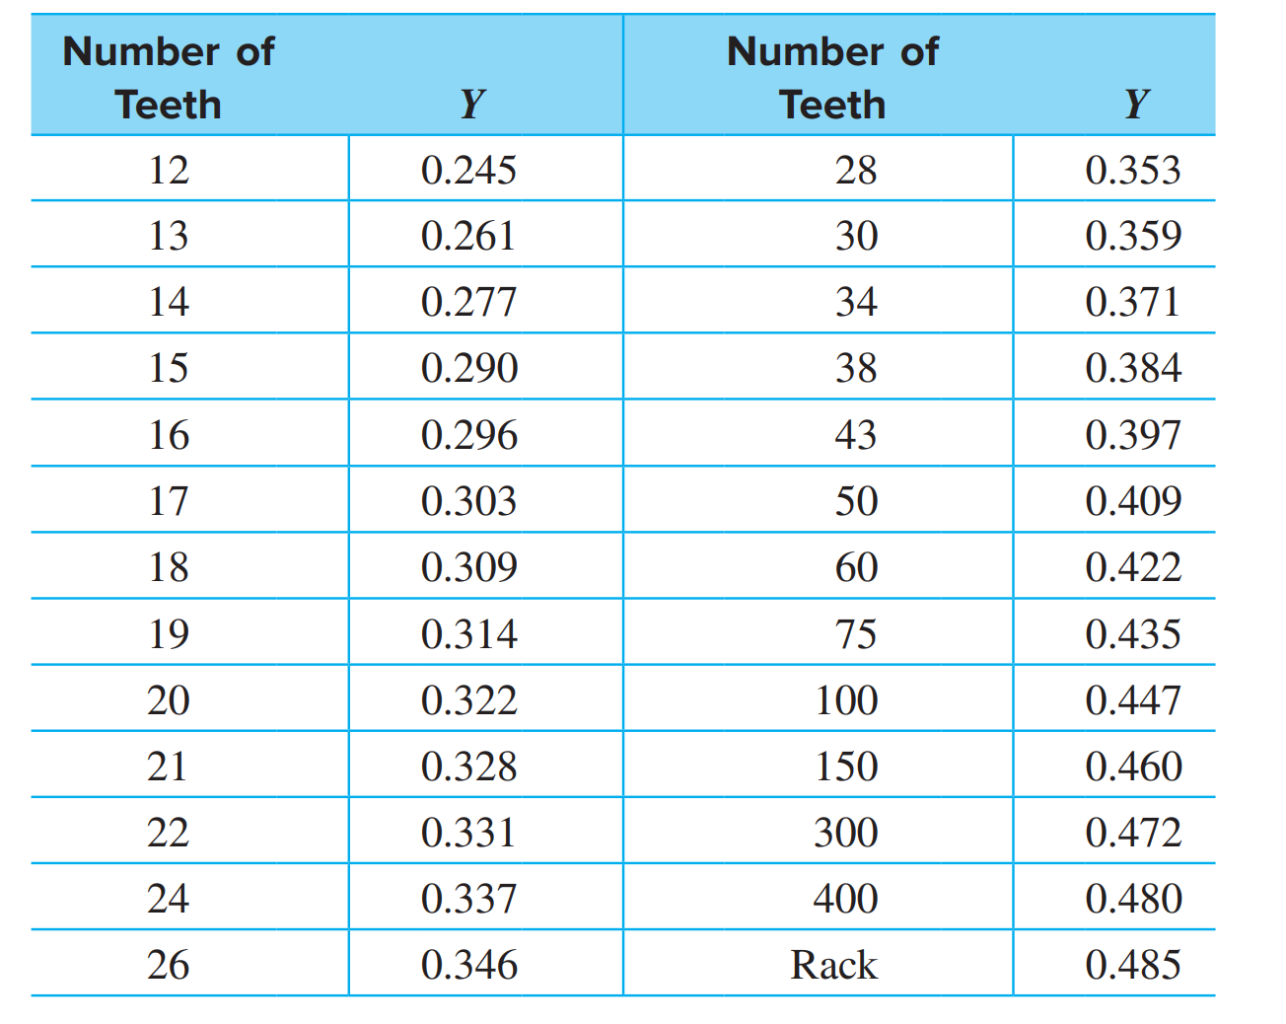
Technical Analysis-Gears

Slide 22
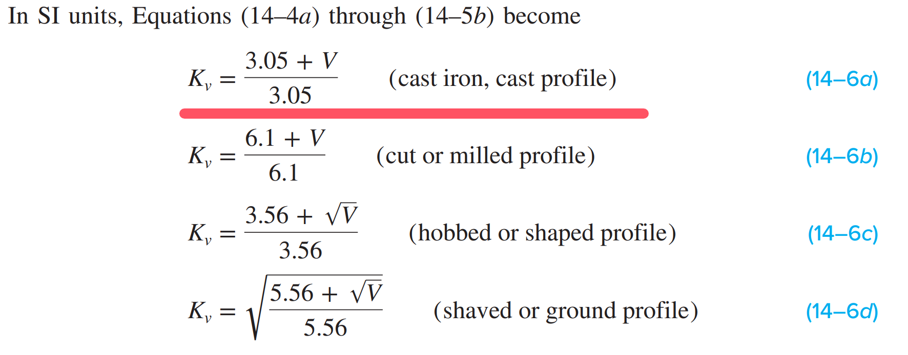
Technical Analysis-Gears

Slide 23
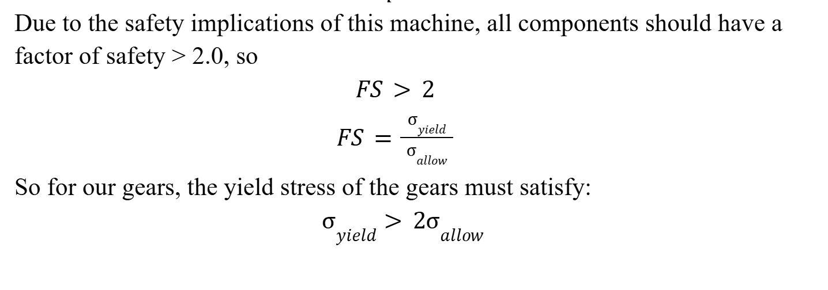
Technical Analysis-Gears

Slide 24
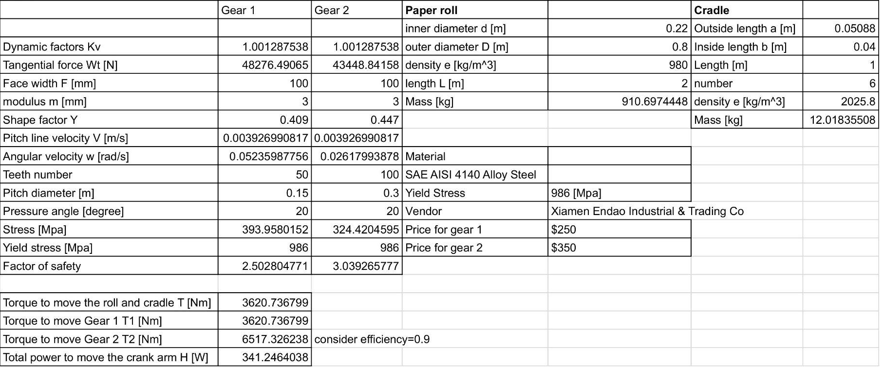
Technical Analysis-Gears-Summary

Slide 25
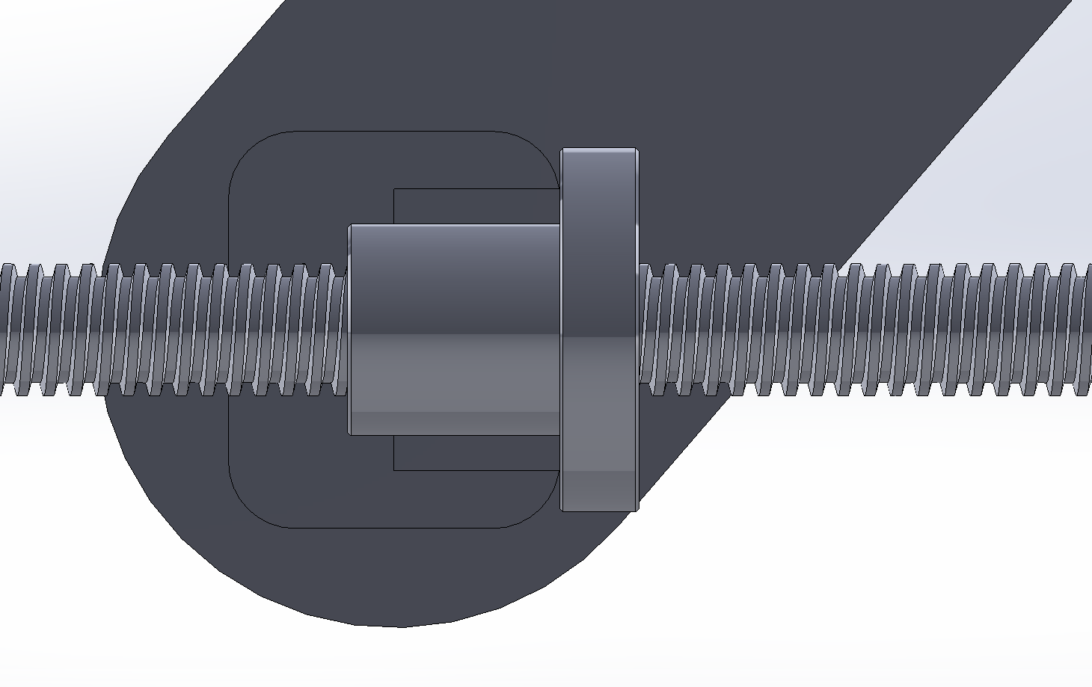
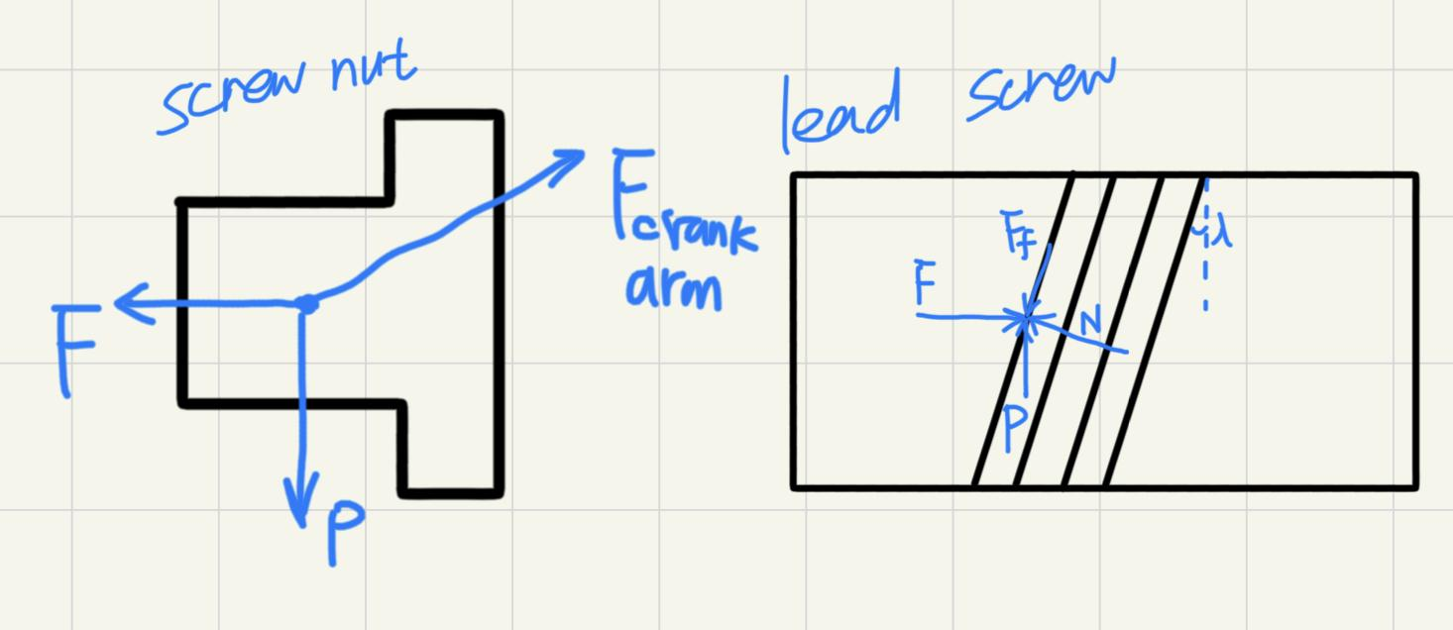
Technical Analysis-Power Screw
Figure and relevant FBD
Notes:
Here is the analysis of Power Screw sets, which contains a lead screw and a screw nut.

Slide 26
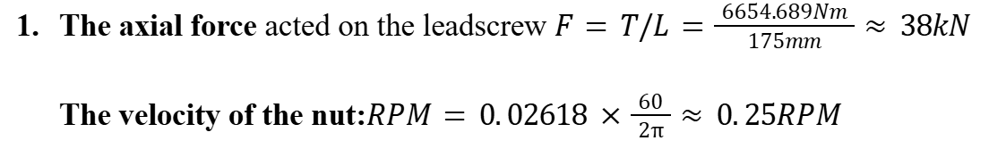
Technical Analysis-Lead Screw
Assumptions:the crank arm to be L=175mm with about a 250mm stroke.
Ignore non-axial force acted on the arm, only consider the compressive load.
Coefficient of friction is to be f ≈ 0.1
Known: total power to move the crank arm H=341.2464038 W
Notes:
It’s a very slow, high thrust.

Slide 27
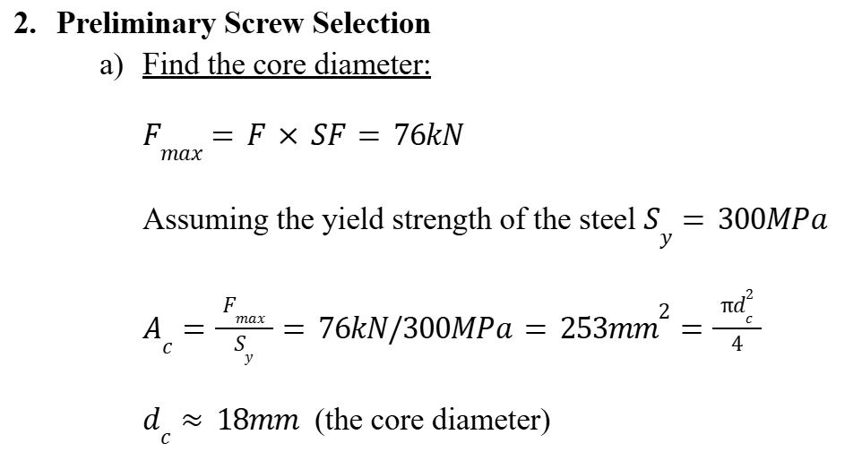
Technical Analysis-Lead Screw

Slide 28
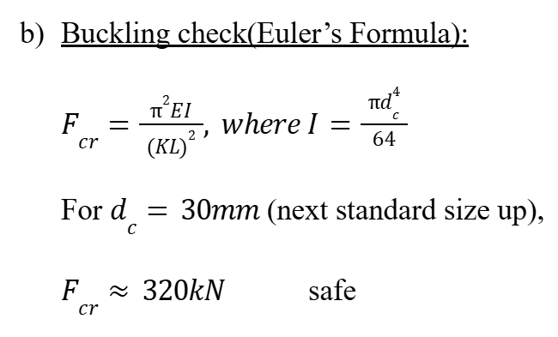
Technical Analysis-Lead Screw
Notes:
since the maximum force is only 76kN

Slide 29
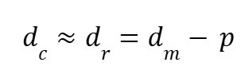
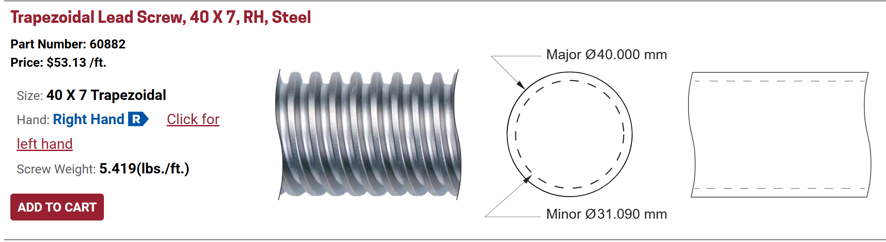
Technical Analysis-Lead Screw
Notes:
knowing the core diameter, which is seen as minor diameter in the shigley’s mechanical engineering deisgn, we can find the major diameter and pitch for the desired lead screw. So we choose Right Hand Trapezoidal Lead Screws for Power Transmission from Roton Products, Inc. for safety and manufacturing standards.

Slide 30
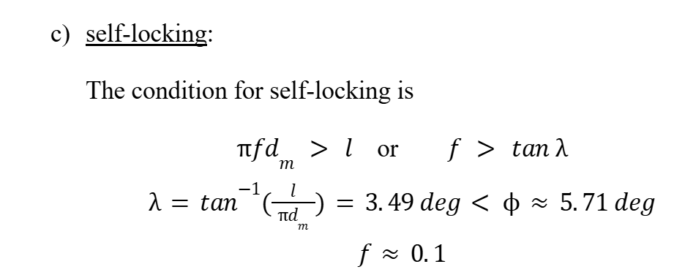
Technical Analysis-Lead Screw
Notes:
Where,
f = coefficient of thread friction
dm = pitch diameter [mm]
l = lead [mm], which equals the pitch p for a single thread
λ =lead angle [deg]
It can fulfill the self-locking condition and avoid an uncontrolled load in case of power failure.

Slide 31
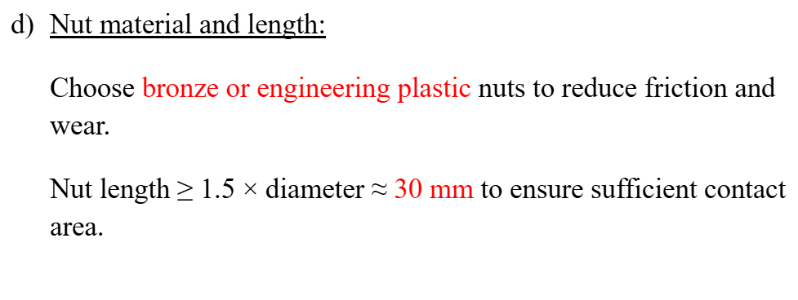
Technical Analysis-Lead Screw

Slide 32
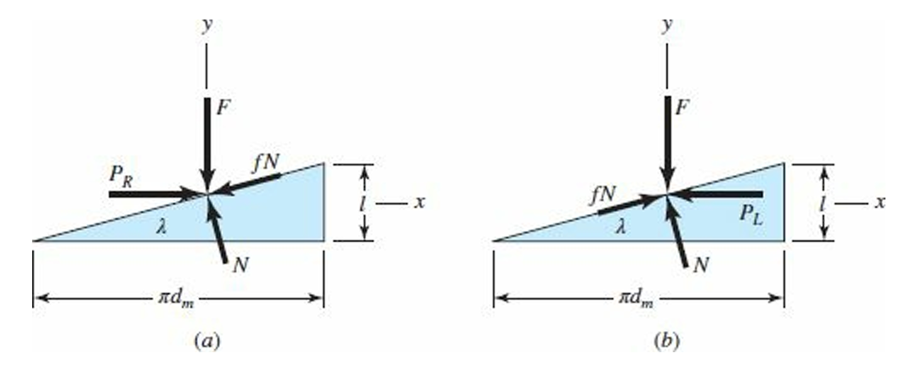
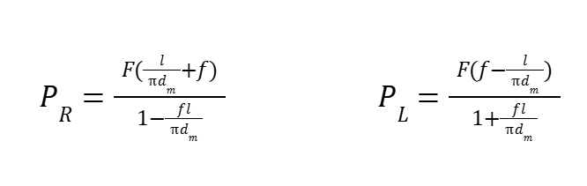
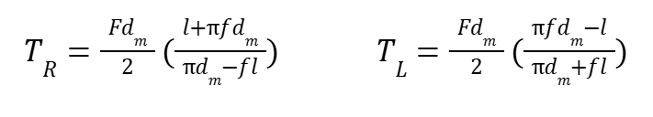
Technical Analysis-Lead Screw
Notes:
this is a more specific FBD for screw threads, we use it and equilibrium equations to determine the force acting on the threads PR and PL.P_{R} is the force to lift the load (defined as the force that makes the cradle to rotate clockwise to convey the paper roll), and P_{L} is the force to lower the load.
Then, find the torque required by multiplying the load P with the mean radius d_{m}/2,

Slide 33
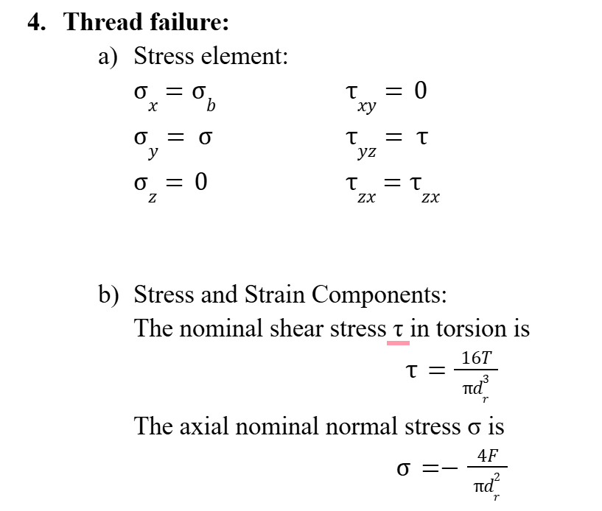
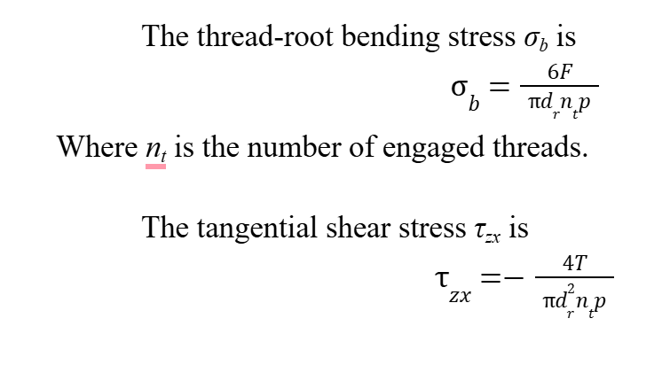
Technical Analysis-Lead Screw
Notes:
We use the von Mises theory to analyze thread failure:
the components:
Where,
dr= minor diameter=d-p, d is the major diameter

Slide 34
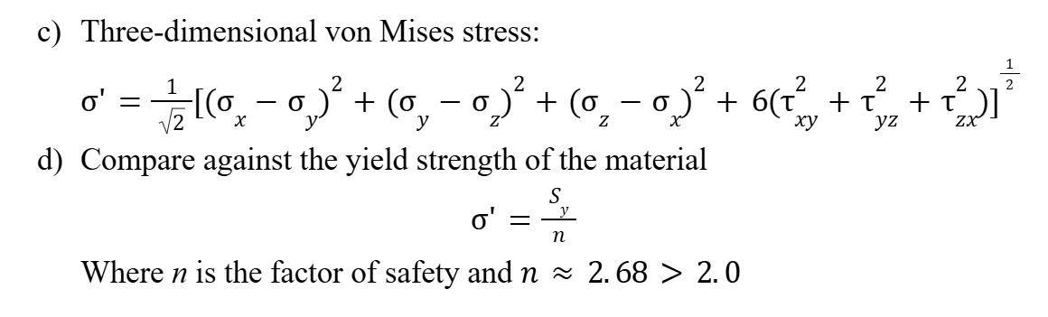
Technical Analysis-Lead Screw
Notes:
we run all the calculations in python and verify that the factor of safety is about 2.68

Slide 35
Key Outcomes-Strengths of the Design
Minimization of Cost
Use of Standard Components:
leverages off the shelf comonents
Reduction in Motor Power and Torque Requirements
Efficient Lead Screw Design:
A trapezoidal thread
Self-locking characteristic
Load Distribution and Bearing Location:
Share effectively across all elements
Notes:
Script:Our design leverages off-the-shelf components such as commercially available gears, bearings, and lead screws. The use of widely available materials like AISI 4140 Alloy Steel helps keep material costs low and simplifies procurement.
The power screw design uses a trapezoidal thread, while providing adequate contact stress distribution, it also facilitates smooth load transfer. Its self-locking characteristic minimizes the chances of back-driving, which in turn means that the motor only needs to supply sufficient torque to initiate motion and overcome static friction, rather than continuously fighting gravity or other reactive forces. This design reduces both the power consumption and the wear on the motor over time.
The design ensures that loads are shared effectively across the different elements—cradle, shaft, gears, and bearings. This clear separation of load paths reduces peak stresses on any one component, thereby reducing the overall power and torque required from the motor to initiate and sustain movement.

Slide 36
Key Outcomes-Expected Points of Failure
Gears
Despite the selection of materials and designed safety factors, high cyclic loads could still lead to wear or fatigue over time. Any misalignment in the gear train or improper lubrication could exacerbate these issues.
Lead Screw
If the friction coefficient changes unexpectedly (due to wear or lubrication issues) or if dynamic loads exceed the estimated values, there is a risk of thread stripping or bending. The self-locking condition is critical for safe operation and any deviation might compromise the system’s integrity.

Slide 37
Key Outcomes-Expected Points of Failure
Bearings
Under continuous operation (16 hours per day, 5 days a week), even slight imperfections in installation or miscalculations in load distribution can lead to premature fatigue or degradation in the bearing surfaces.

Slide 38
Bill of Materials
Part | Product Name | Material | Quantity | Yield Stress[Mpa] | Cost[$]
Gear 1 | Spur Gear 3M 50T 20PA 100FW | SAE AISI 4140 Alloy Steel | 1 | 986 | 250
Gear 2 | Spur Gear 3M 100T 20PA 100FW | SAE AISI 4140 Alloy Steel | 1 | 986 | 350
Lead Screw | Trapezoidal Lead screw, r40x7, RH | AISI 1018 Carbon Steel | 1 | 300 | 174.3
Screw Nut | Trapezoidal Sleeve Nut, 40x7, RH | Bronze | 1 | - | 137.71
Flange | Flange, 1.967-18 UNS, Tr40x7, RH | Steel | 1 | - | 75.82
Notes:
Here is the bill of materials after all analysis and calculations are done. Two gears, lead screw, screw nut, flange,

Slide 39
Bill of Materials
Part | Product Name | Material | Quantity | Dynamic Load (N) | Static Load (N) | Vendor | Cost[$]
Bearing A | SELF ALIGNING ROLLER BEARING 22210-CA-W33-C3 | / | 1 | 8.45x10⁷ | 1x10⁸ | 123BEARING | 34.56
Bearing B | Needle-Roller Bearings 5905K563 | Steel | 1 | 38477 | 83849 | McMaster | 31.24
Pillow Block A | SNL210 plummer pillow block housings | Cast iron | 1 | - | - | MiMOTION | 439.04
Pillow Block B | Housed Bearing UCP212 | Cast iron | 1 | 5x10⁷ | 3.45x10⁷ | 123BEARING | 32.72
Notes:
and two bearings with pillow block are included. The total cost is 1519.39 dollars.

Slide 40
Summary
Design the paper roller transfer machine with specific components and positions
Analyze the power need to transfer
Components designed with factor of safety > 2.0
Calculate the torque required for gears and crack arm movement
Force required from the lead screw
Ensure the bearings satisfy the lifetime requirements
Prons
Cost-effective ($1525.39)
Lower motor torque
Reduce the misalignment risk in some degree
Lead screw is self-locking for passive safety
Cons
Requires proper lubrication to avoid wear
Bolted connection to base not analyzed
Only one bearing is self-aligning
Notes:
For this project, we successfully design the paper roller transfer machine with specific components and actual positions. We first determined the model and had the CAD model, then analyzed the power need to transfer, calculated the torque required for gears and crack arm movement, force required from the lead screw. We also make sure all components can work without fatigue and break accroding to fator of safety and both dyanmic and static laod capacities for bearings. And finally looked for the suitable off-the-shelf components
Our project is cost effective, and lower the motor torque thanks to lead screw and gear ratio optimization. The bearing A is a sel-aligning bear help reduce the misaligning risk. Besides the Lead screw is self-locking, providing passive safety during power loss.
However, Proper lubrication is required to avoid unexpected friction and component wear. In addition, we did not include the bolted analysis, which needs to be refined in the future

